Slide 1
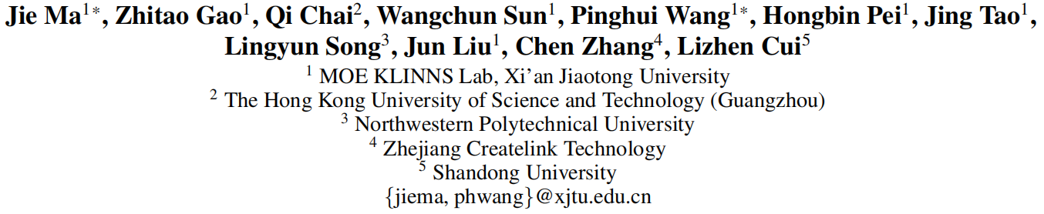





Debate on Graph: A Flexible and Reliable Reasoning Framework for Large Language Models
（AAAI-2025)
Code — https://github.com/reml-group/DoG
Reported by Jiale Shen

Slide 2
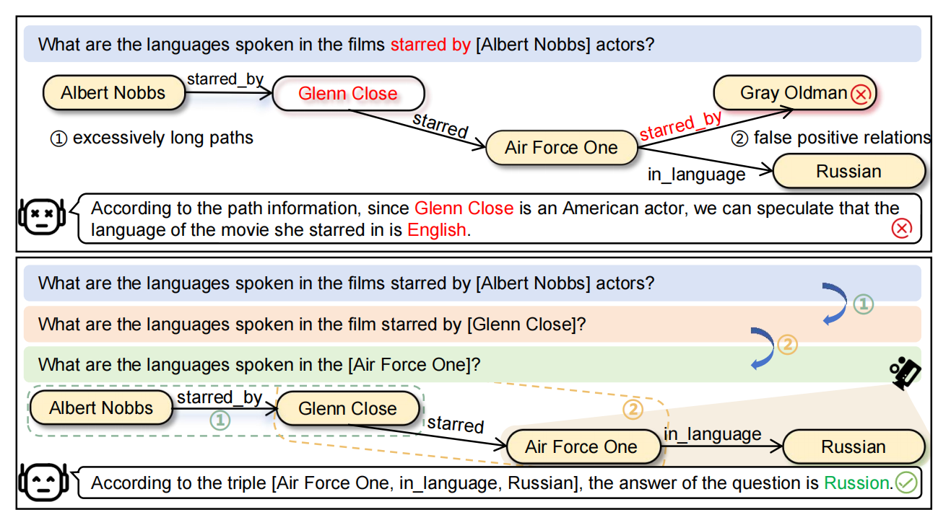
motivation
1.This task requires LLMs to answer natural language questions by retrieving relevant triples from knowledge graphs. However, existing methods face two significant challenges: excessively long reasoning paths distracting from the answer generation
2. false-positive relations hindering the path refinement.

Slide 3
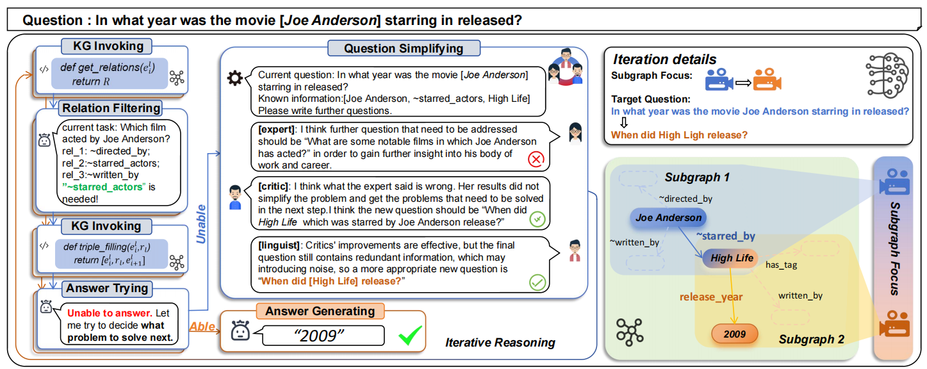
Overview

Slide 4
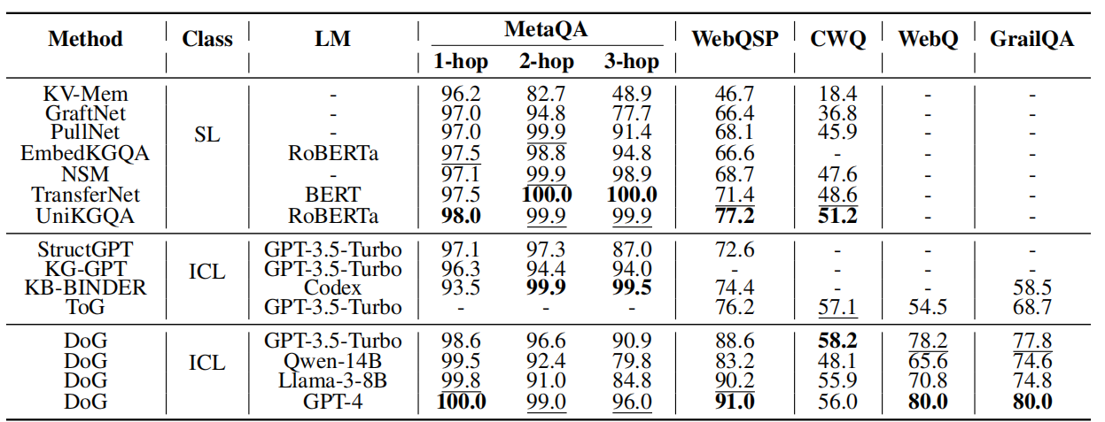
Experiment

Slide 5
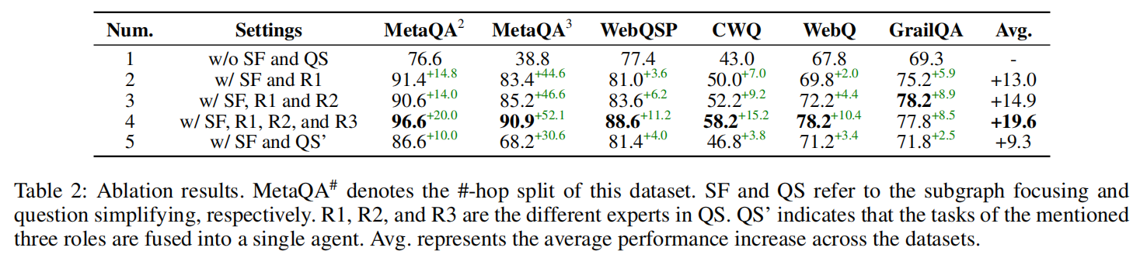
Experiment

Slide 6
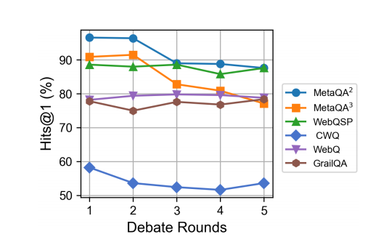
Experiment

Slide 7
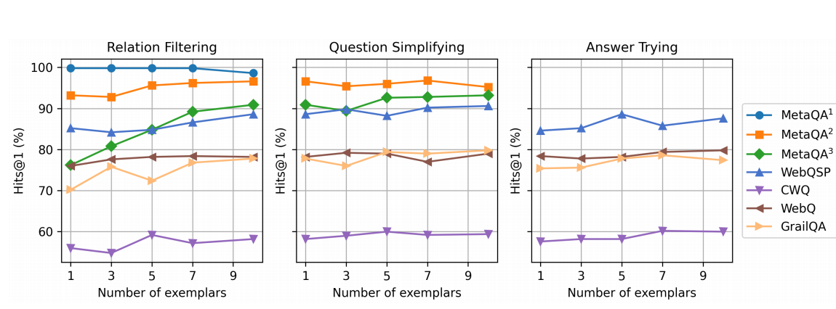
Experiment

Slide 8
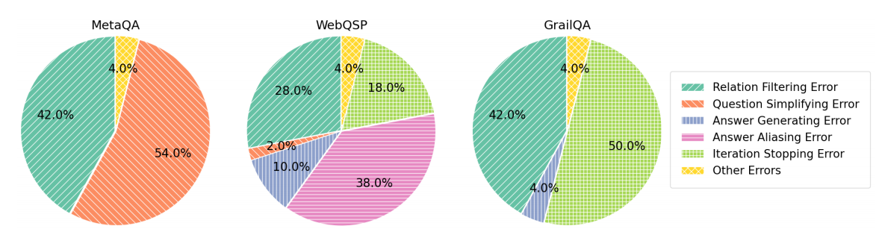
Experiment

Slide 9
Thank you!

